Slide 1


VACCINE
REGISTRATION PORTAL
Jenfer Rithika MS194414 Nitya MS194418
Arya MS194411 Uma MS19904

Slide 2
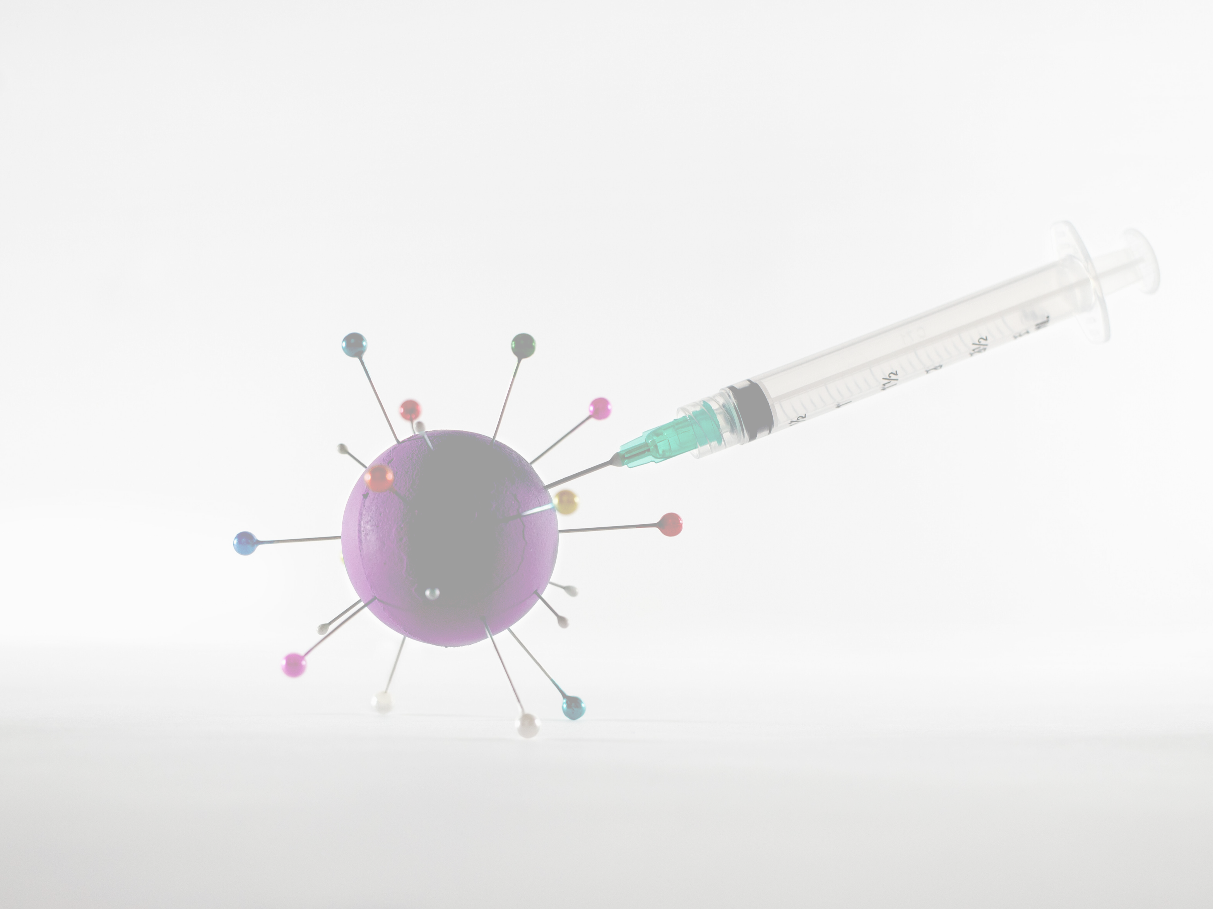
Introduction:
Government of Karnataka is taking all necessary steps to ensure that the nation is prepared to face the challenge and threat posed by the growing contagion of COVID-19. The exemplary groundwork and precaution advisory by the Government has helped in containing the spread of the virus in our country. At present, the priority is to make
COVID -19 vaccine traceability and be
ilable to all, ensuring vaccine ciary tracking from production to
last mile administration.
COVID-19 Vaccination drive was initiated to cover healthcare and frontline workers and scaled up to cover citizens above 45 years of age. Now, the vaccination has opened up to cover all citizens aged 18 years and above.

Slide 3

We Created a ( drive in Karnat number of vacci
bsite name) or portal for va With scaling up of vaccin
ti he
to be
ion facilit
nd sessio
ely. This ebsite name
increased and ma ag f
tal )will facilitate n
an option to
re Cente module
a s hedule the va cina on session online in heir choice. The Citizen self-registration ensure fool-proof identification of de
for receiving the vaccines.
candida

Slide 4





Objectives:
Login
Citizen login to (website name)
Citizen login with mobile number and otp Registration
Citizen register by filling required details.
Citizen can register and add others(Friends, Family Members) for Vaccination.
Schedule Vaccine Appointment:
Citizen schedules appointment at the nearby vaccination center Cancellations/Rescheduling avaliable

Slide 5

Confirmation of appointment:
Citizen Can download the appointment Slip Appointment is also shared as Sms on registered mobile number.
Vaccination Completed:
Citizen get vaccinated at the selected center after completion they can download there Ceritificates from our portal.
Citizen can book there apointment for Second dose after 28days and they can keep track for there second dose.

Slide 6

Problem Statement: Building a vaccination drive Synopsis:
Vaccine Registration Portal for the GENERAL PUBLIC.
Centeral Govt Entity POV.
To vaccinate everyone in the country.
To track the available status of the vaccine. People and Vaccination center.

Slide 7

Modules:
Registration module : This module contains the details of registration on Vaccine portal Appoinment Scheduling : This module contains, a calendar and an timer to set the particular appointment for vaccination
Booking Location : In this module, the admin locates the center/ Hospital for the vaccination Add member : This module contains, a new registration form, such that a new member in a family can share the access.
Certificate generator : In this module, once when the vaccination is taken, a certificate will be generated by the admin.

Slide 8

Trend Analysis (Admin side)(Additional): In this module we set the trend analysis based on doses taken by the People of India.

Slide 9

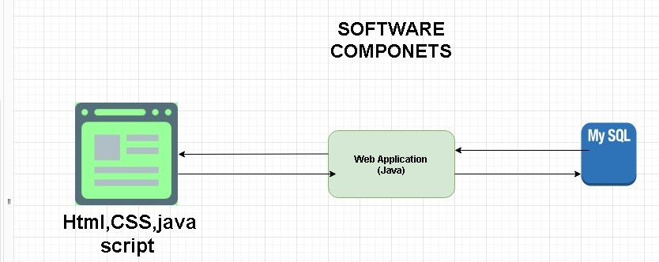
Software and Hardware Requirements:

Slide 10

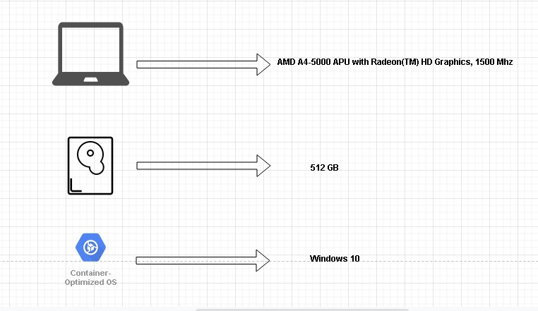

Slide 11
Data Dictionary Appointment table data dictionary
Persons table data dictionary

Slide 12

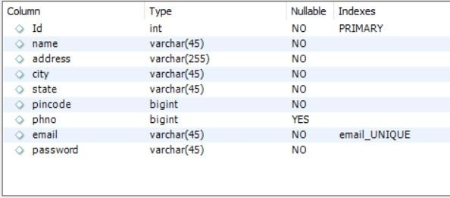
Vendor table data dictionary

Slide 13

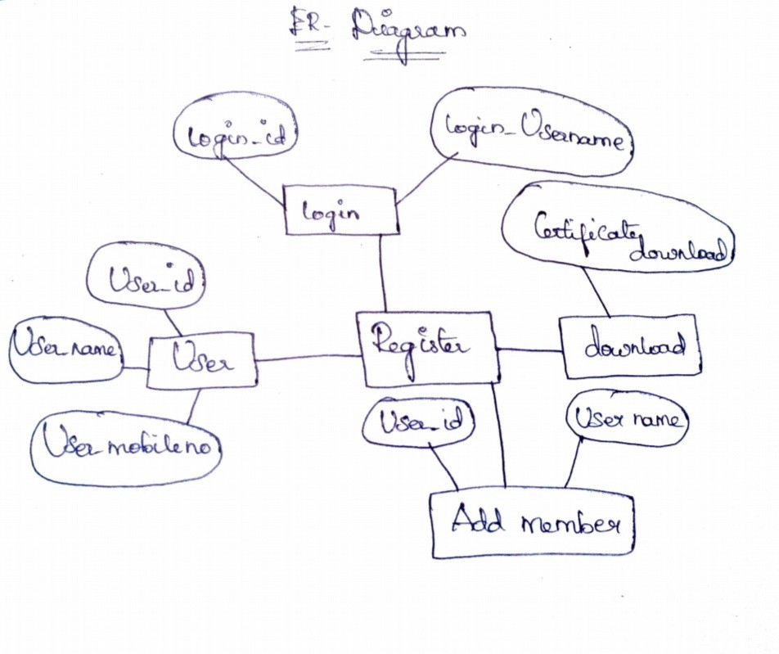

Slide 14
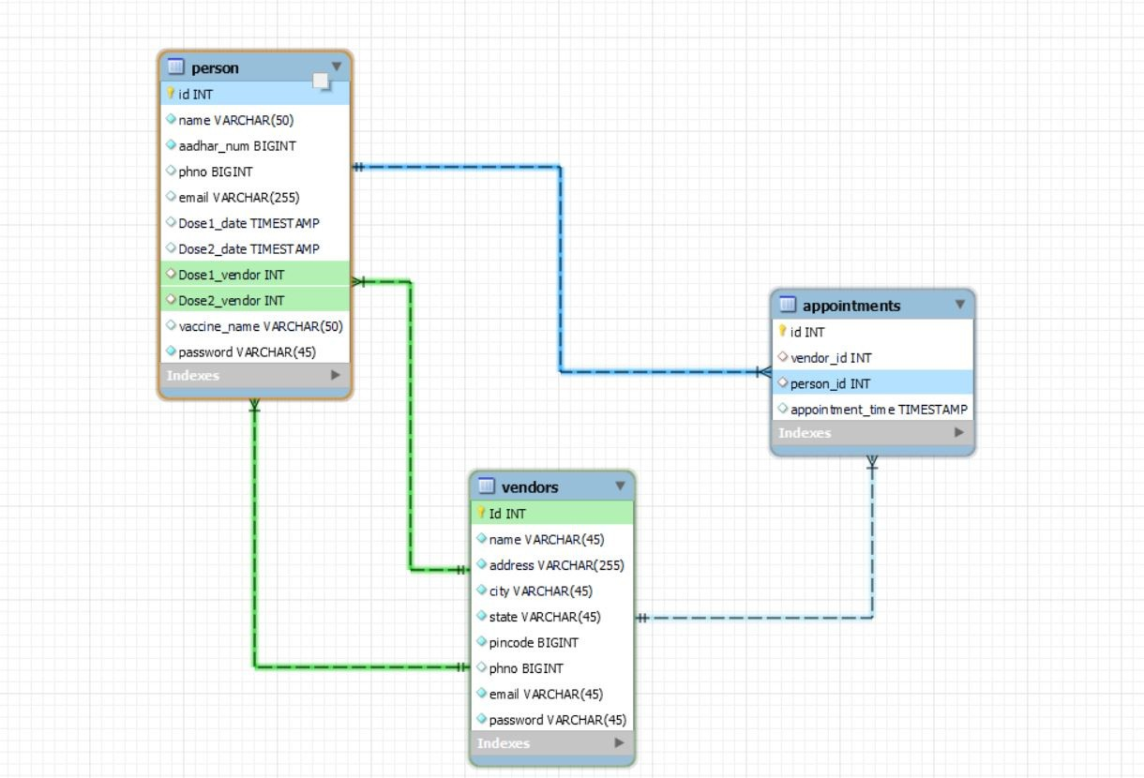

Slide 15

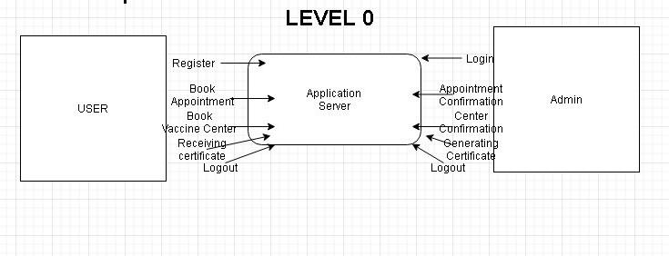
Data Flow Diagram:

Slide 16

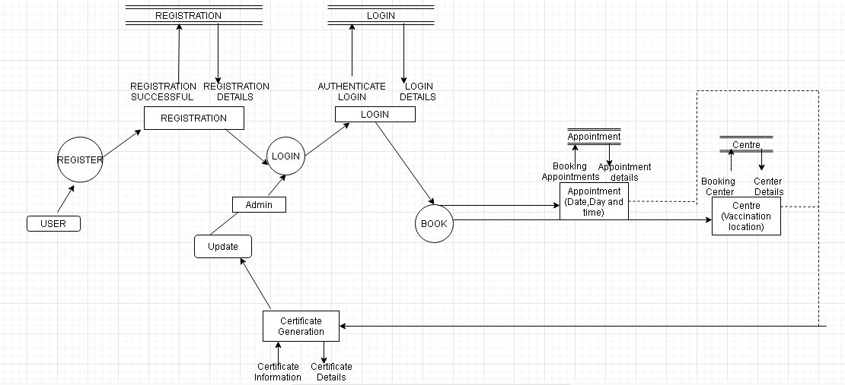
LEVEL 1

Slide 17
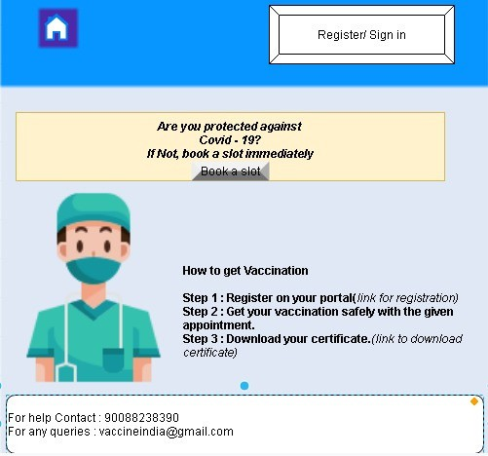
Demo Pages:

Slide 18
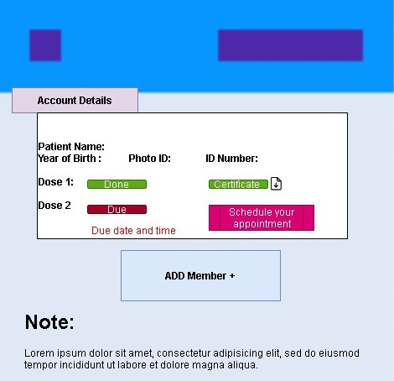

Slide 19
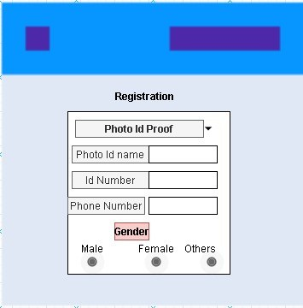

Slide 20
Bibliography:
https://www.w3schools.com/php/default.asp https://www.w3schools.com/mysql/mysql_r
dbms.asp https://www.javatpoint.com/servlet-tutorial
https://www.w3schools.com/css/default.asp https://www.geeksforgeeks.org/introduction-
of-er-model/

Slide 21
Conclusion
Our project Covid Vaccination Portal are yet to be designed and tested
Integrating features of all the software, we are going to develop our project
This project's main goal is to make Citizens of
India to be safe from Covid 19 and to decrease the rate of sickness
This project will decrease the human effort, makes users to use more ease.

Slide 22
Admin has a different access and it makes the job ease!
Also, our main intention is to make India Covid free! In order to acheive that we need to take up
Vaccine and this portal helps our citizens to access it and to keep track when and where they should
take up their vaccines.

